Slide 1
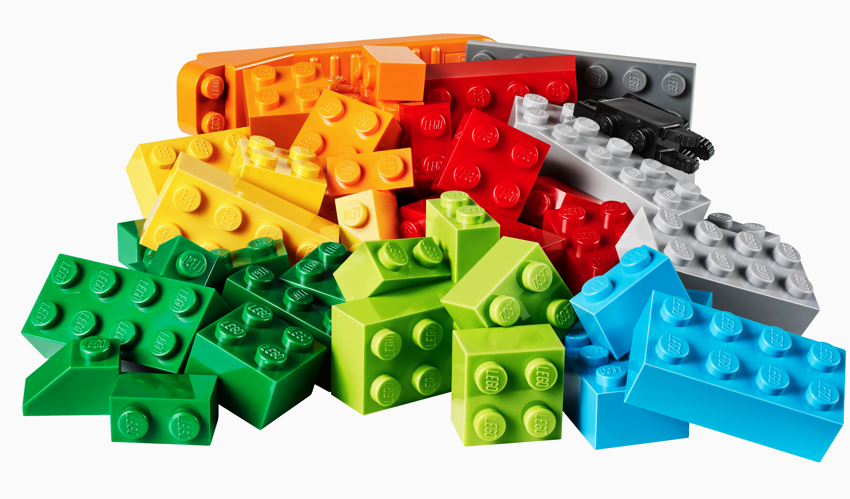
Team LEGGO
Kerry McConnaughay, Annie Kroo, Ana Krishnan, Onur Talu, Anil Patel

Slide 2
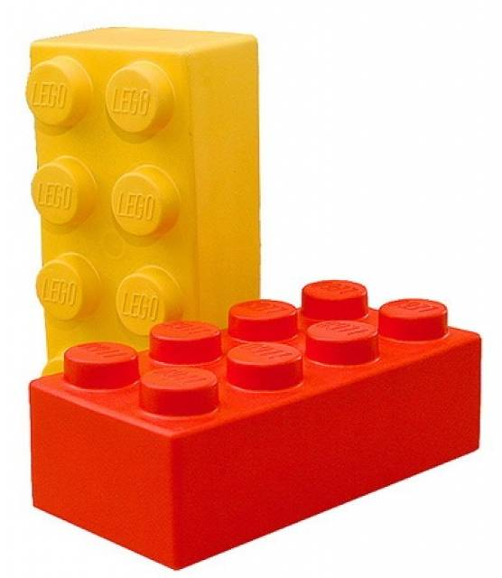
Agenda
Background
What we hope to get out of this
Architectural Discussion
Key Questions
Feedback

Slide 3
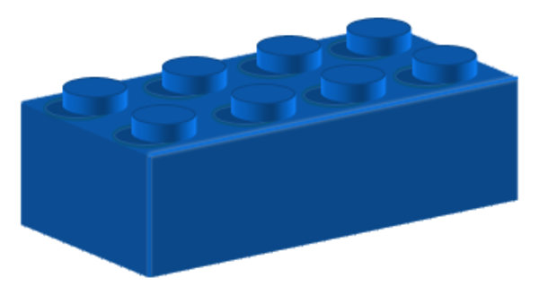
What is our project?
Input an image and other information with the user interface.
Resize and pixelate the image using numpy and pillow.
HTML parsing for colors and prices.
Display our new “Lego-bricked” image alongside required bricks and cost.

Slide 4
What do we hope to get out of this?
Constructive feedback on how to approach our challenges differently (using classes).
Get ideas on how to structure our code to achieve our stretch goals.
Get more ideas for going beyond on our project further. Go beyond Legos (i.e. Mike-n-Ike’s)?

Slide 5
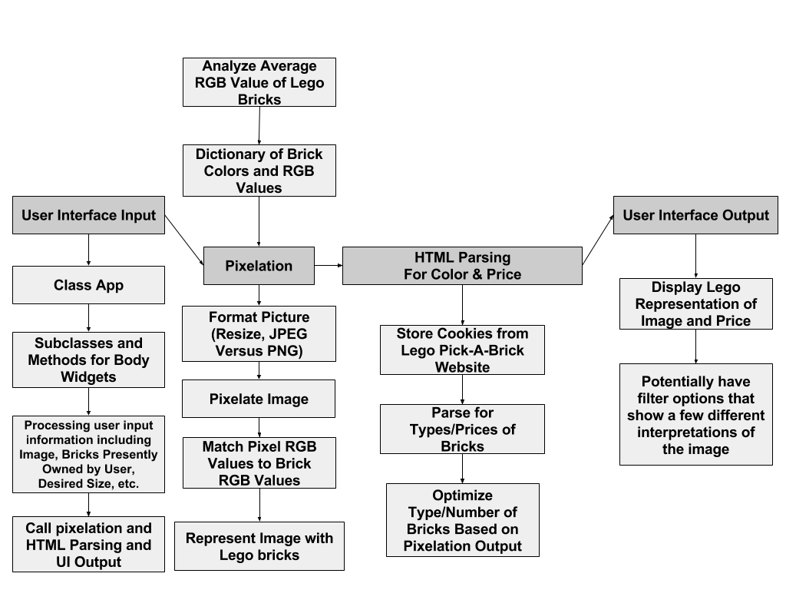
Architecture

Slide 6
Architecture
4 Major Sections
User interface input - will give the data from the user to the pixelation portion of our code
Pixelation - will pixelate the image and determine how many of each color lego is needed. This information will then be handed off to the HTML
HTML parsing for color and price - will scan the LEGO website and price each of the LEGOs needed to make up the image.
User interface output - LEGO bricked image created by the pixelation portion will be displayed by the user interface output alongside the price generated by the HTML parser

Slide 7
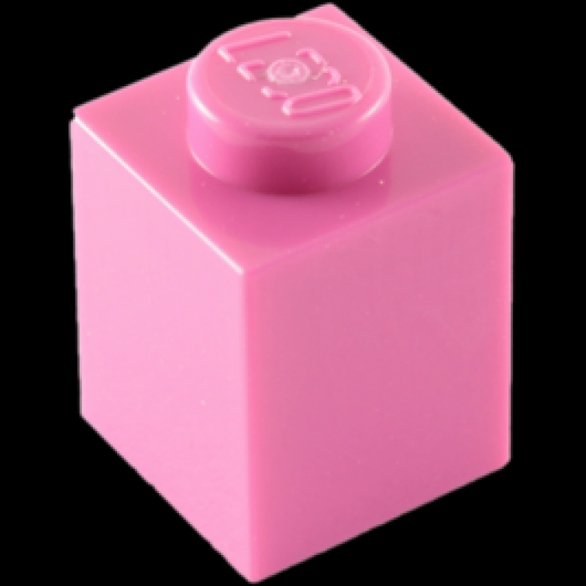
Pixelation Architecture
Analyze average RGB value of every color Lego brick
Store in dictionary
Compare to pixels of user’s input image

Slide 8
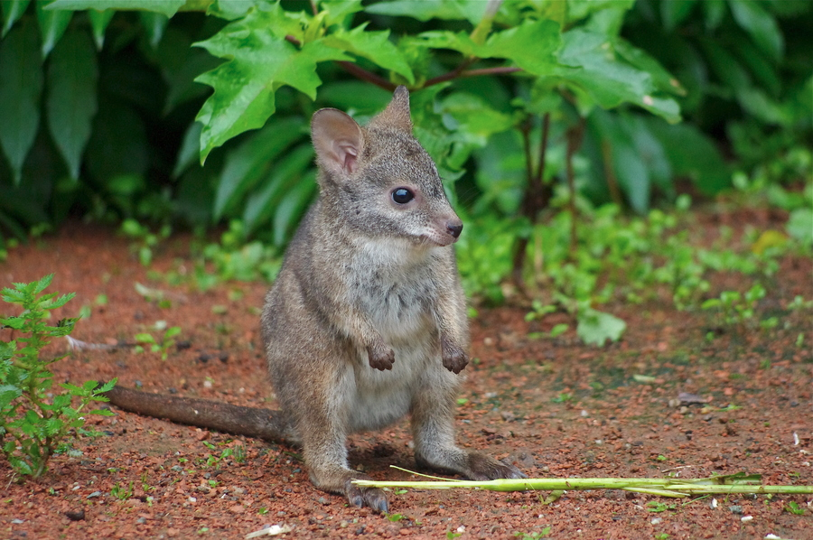
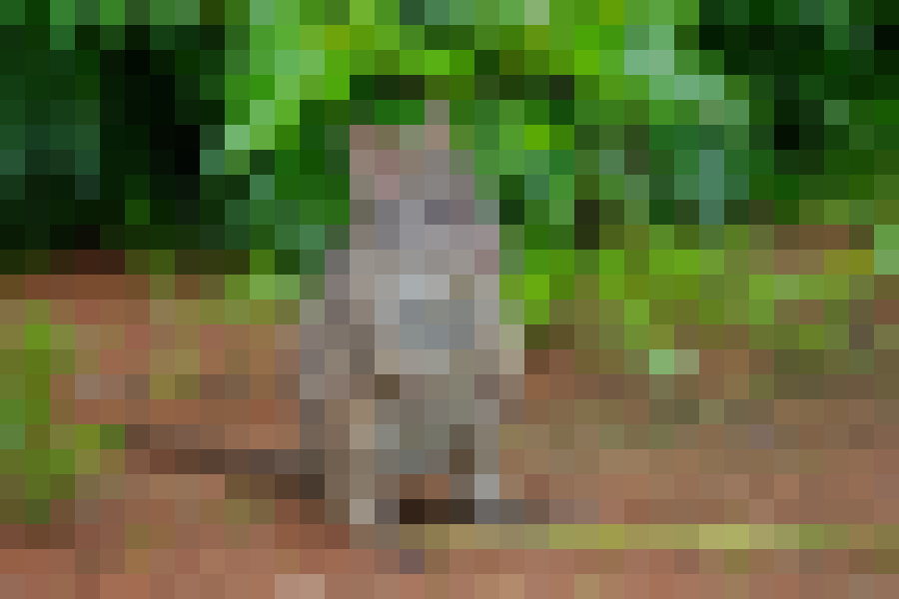
Pixelation Architecture
Make array from image
Average RGB of 1 pixel group
Create a new pixel with all average RGB
Populate new array and loop through the image

Slide 9


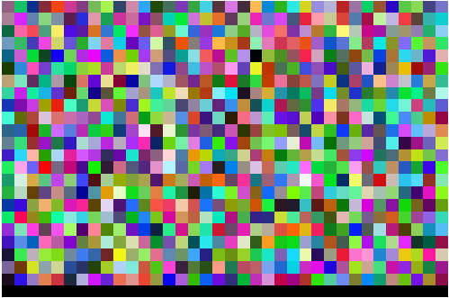
Pixelation Challenges
Should display Does Display (????)
RGB value we calculated:
[12, 52, 4]

Slide 10
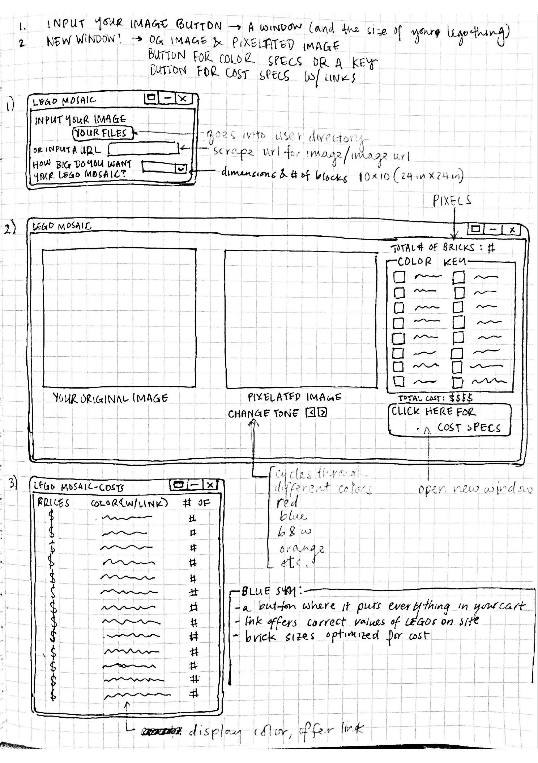
User Interface Architecture

Slide 11
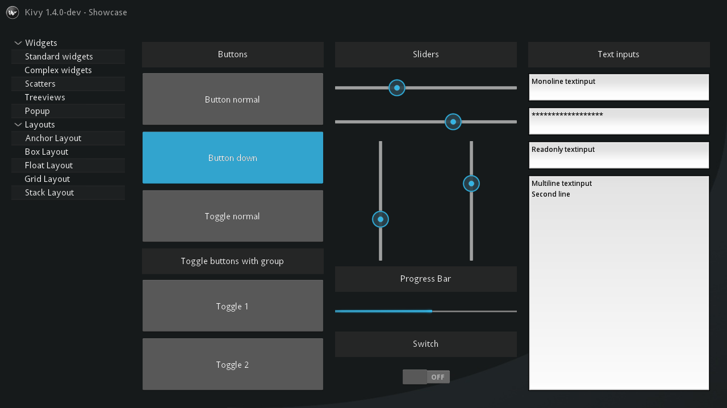
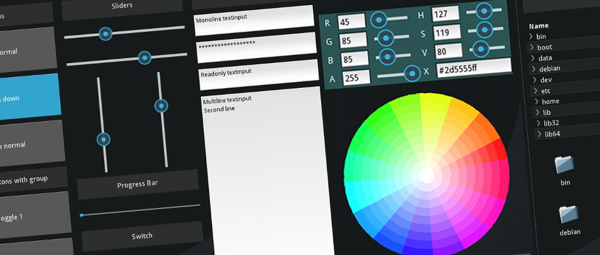
User Interface Challenges
Learning how Kivy works
Learning how to use and implement Kivy modules

Slide 12
HTML Scraping Challenges
Still working on how to scrape from a website without a unique URL
Figure out how to get data from the Lego Pick-A-Brick website
The website does not have a unique URL

Slide 13
Key Questions Selected
Is there a Python library we could use to more efficiently pixelate our images?
What stretch goals should we gear our code toward/which stretch goals are most interesting?
What would you want this program to return if you were our user (instructions for construction, image with Lego bricks instead of pixels, different versions of the “Lego-bricked” image, etc.)
What is the best way to scrape a website without a unique URL?
Notes:
Anil
Annie
Ana
Kerry

Slide 14


You’re awesome! Everything is awesome!
Thank you!

